Slide 1
Chapter 13
Graphics

Slide 2
Topics
Graphics class
Overloading paintComponent method
Drawing
Fontmetrics

Slide 3
Preliminaries
Each GUI component has a graphics context
“Think of GUI component as your paper, and each Graphics method is a pencils”
Graphics class is abstract
When a component is displayed, JVM creates a Graphics object for the native platform
  Passes this object to “paintComponent” method
  Invoke it to display your drawing

Slide 4
Method: paintComponent
It is defined in JComponent, and we need to override it to paint
Method signature:
  protected void paintComponent(Graphics g)

Slide 5
How to draw?
Always extend JFrame for your GUI
Write a separate class that extends JPanel
In your extended panel class:
  Overrides its pantComponent, don’t forget the @Override notation
  Specify what to draw
The constructor or your frame declares and add an object of your extended panel

Slide 6
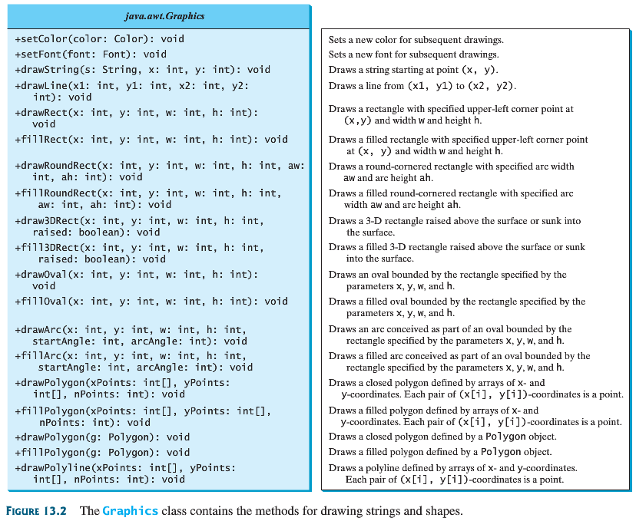

Slide 7
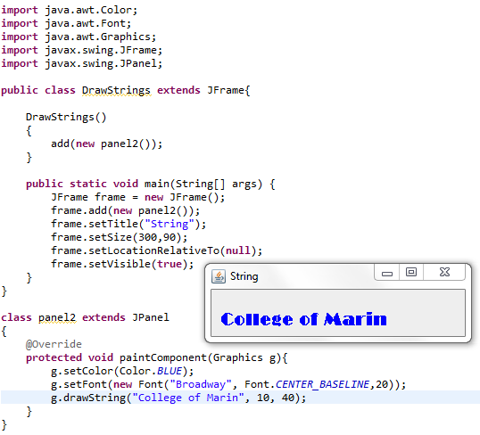
Example: drawString

Slide 8
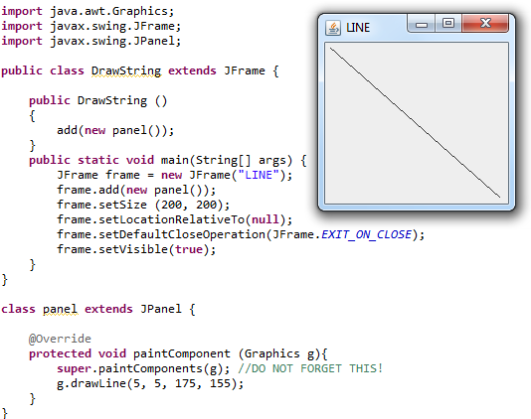
Example: drawLine

Slide 9
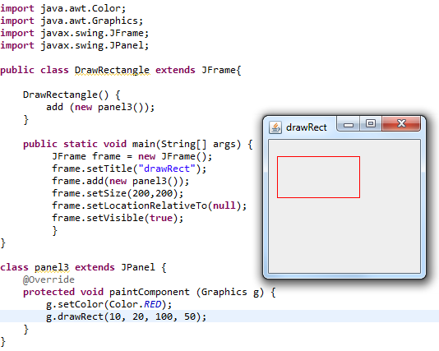
Example: drawRect

Slide 10
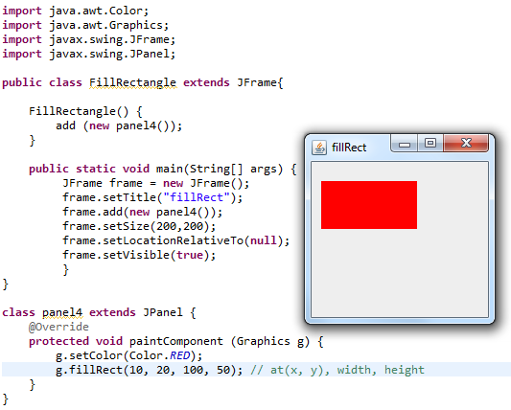
Example: fillRect

Slide 11
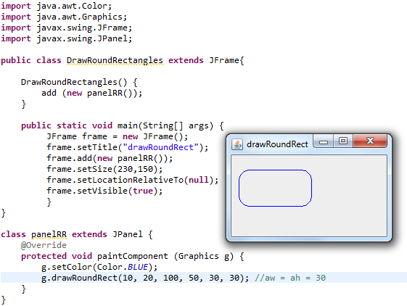
Example: drawRoundRect

Slide 12
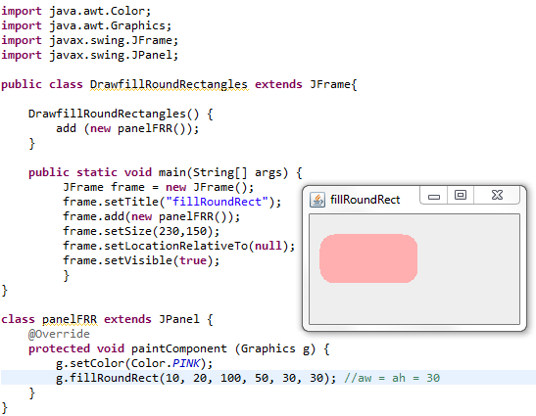
Example: fillRoundRect

Slide 13
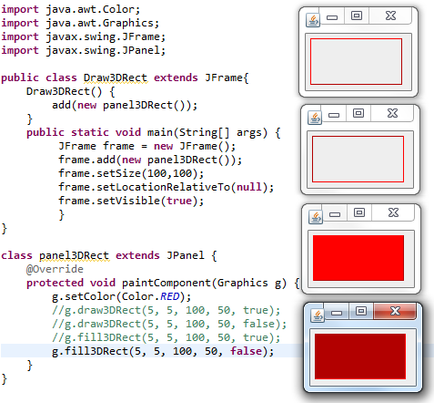
Example: draw3DRect, fill3DRect

Slide 14
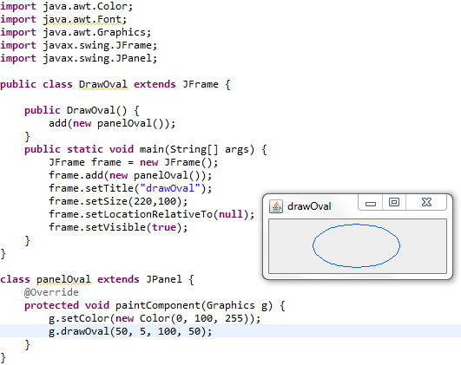
Example: drawOval

Slide 15
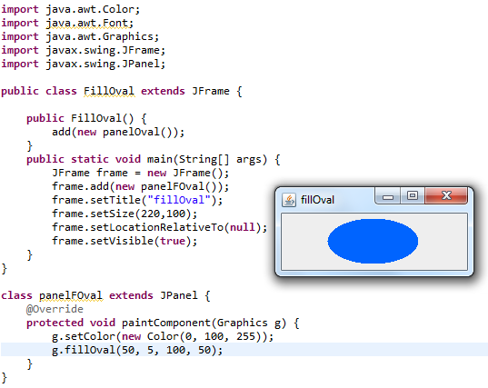
Example: fillOval

Slide 16
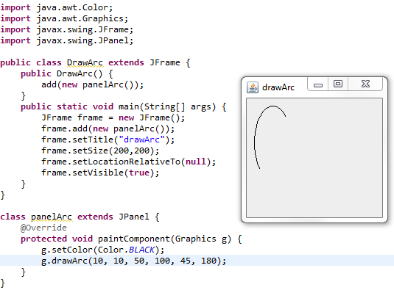
Example: drawArc

Slide 17
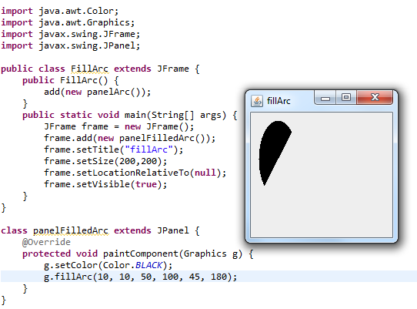
Example: fillArc

Slide 18
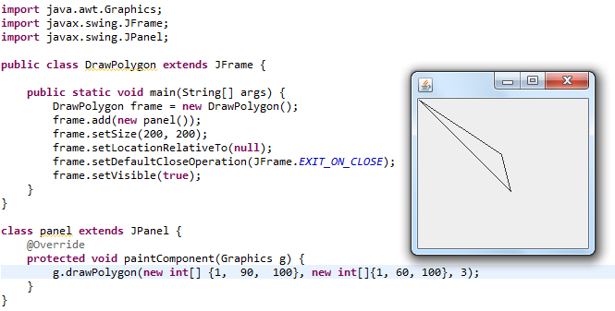
Example 1: drawPolygon

Slide 19
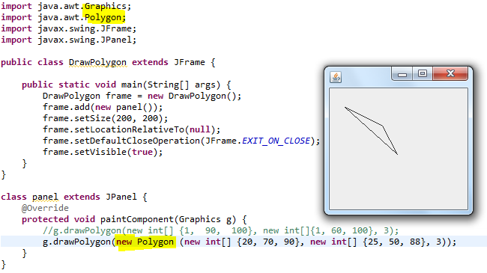
Example 2: drawPolygon

Slide 20
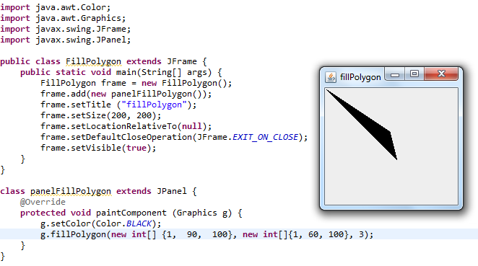
Example 1: fillPolygon

Slide 21
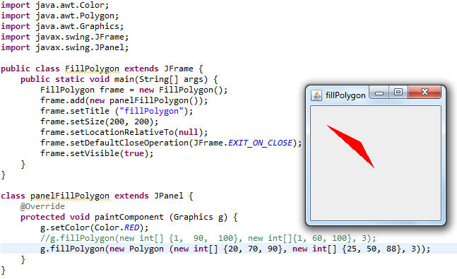
Example 2: fillPolygon

Slide 22
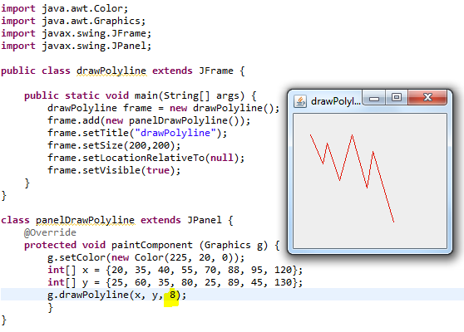
Example: draw polylines

Slide 23
FONT METRICS

Slide 24
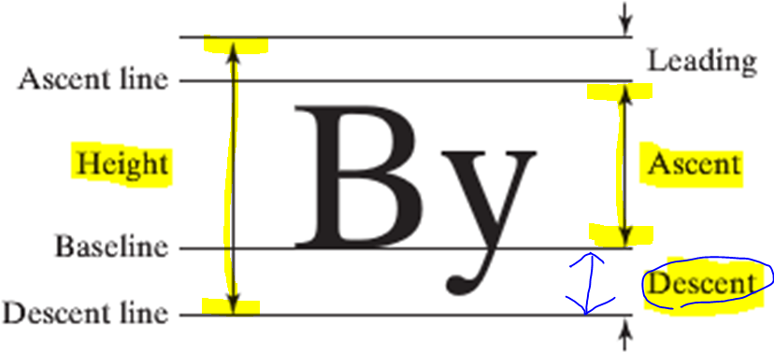
Font Properties

Slide 25
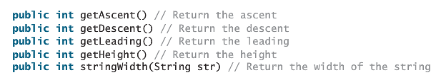
FontMetrics class
Useful methods

Slide 26

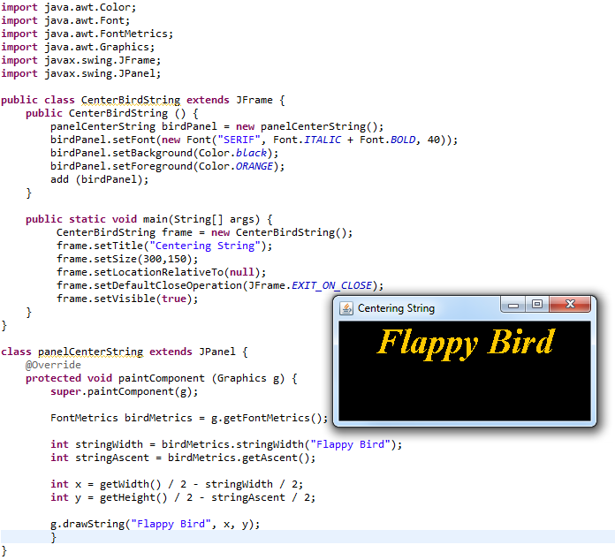
Centering a string

Slide 27
Exercise 1
1. Draw a 6 sided polygon, painted with a color object created with your choices of RGB values
2. Draw a filled 6 sided polygon, painted with a color object created with different choices of RGB values
3. Draw a polyline of 10 edges, painted with a statically defined color value in the Color class

Slide 28
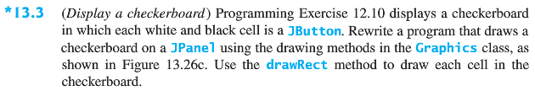
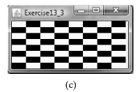
Exercise 2

